Slide 1
Kafka Server Configuration and usage

Slide 2
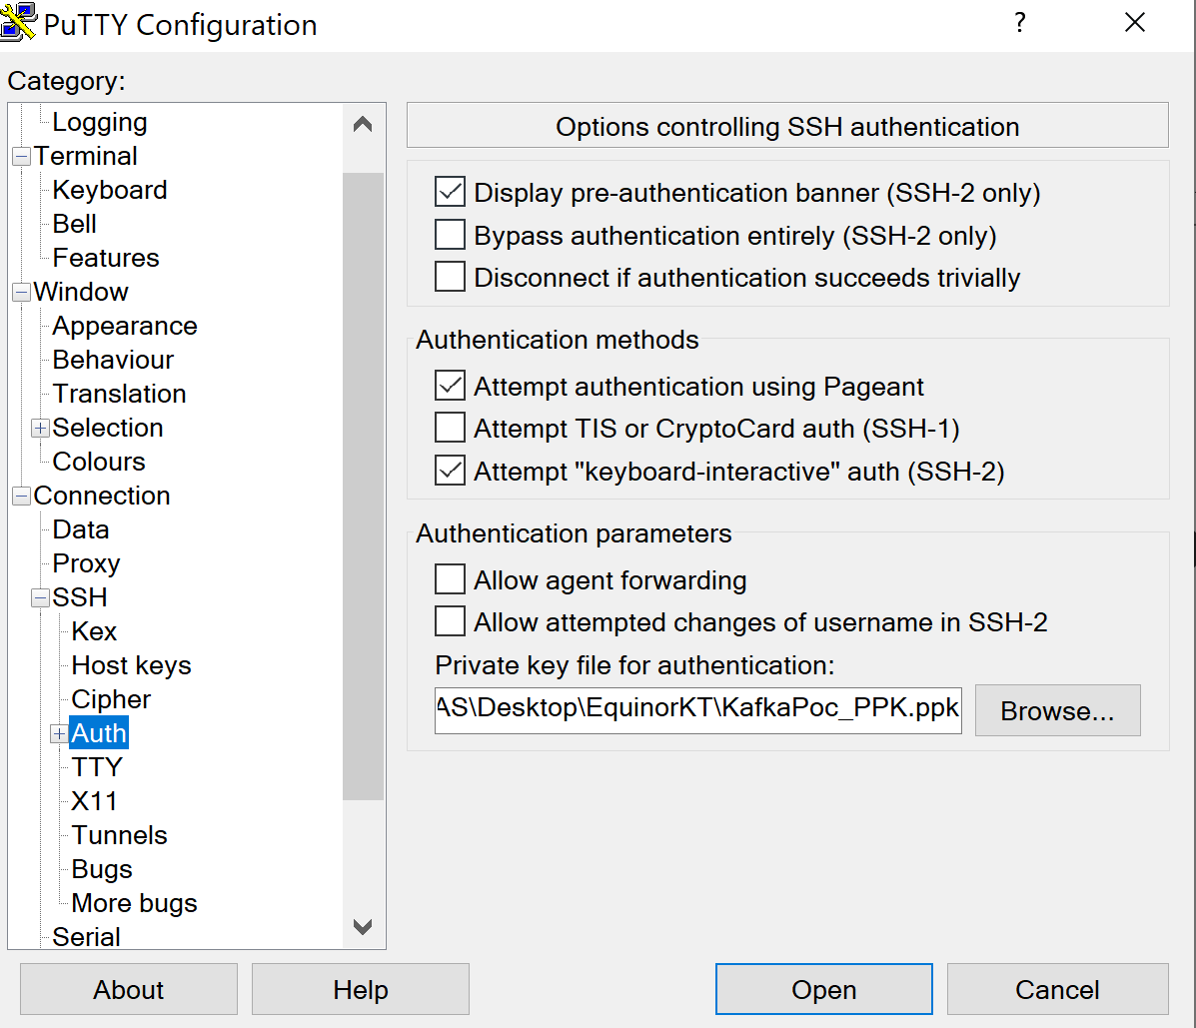
Login Into Kafka Server using Putty
Here attaching Private key of Kafka server to connect from putty so configure this .ppk file in Putty as below in Auth configuration section and provide Kafka server IP 20.251.51.7 and Port 22 and connect

Slide 3
Kafka server and connector Start Commands after Kafka Installation and login into Kafka Server using Putty
To Start Kafka server first need to start Zookeeper and after that Kafka Server as below
Kafka Server installation location is /opt/kafka
Start Zookeeper
sudo bin/zookeeper-server-start.sh config/zookeeper.properties
Start Kafka Server
sudo bin/kafka-server-start.sh config/server.properties
Start Specific Connector
./connect-standalone.sh ../config/connect-standalone.properties ../config/smdajdbc-postgresql-source-bulk-apiwellheaderview.properties
Note: Copy related database connector jar in /opt/kafka/libs Folder then start the Connector
Note: If need to start more than one connector at same time then give space between connector property file and specify all connector file locations in same ./connect-standalone.sh ../config/connect-standalone.properties command

Slide 4
Connector Files Location and Usage
JDBC Connector Property file
Debezium Connector Property file
Elasticsearch Connector Property file
These files location on Kafka Server is at /opt/kafka/config
Log files location of Kafka is /opt/kafka/logs

Slide 5
Produce and Consume Messages from Kafka Topic Using command Line and few other important commands
Cd /opt/kafka
Create Topic
sudo bin/kafka-topics.sh --create --topic quickstart-events --bootstrap-server localhost:9092
Producing messages
sudo bin/kafka-console-producer.sh --topic quickstart-events --bootstrap-server localhost:9092
Consuming Messages
sudo bin/kafka-console-consumer.sh --topic quickstart-events --from-beginning --bootstrap-server localhost:9092
Describe Topic
sudo bin/kafka-topics.sh --describe --topic quickstart-events --bootstrap-server localhost:9092

Slide 6

Connect Kafka Server from Kafka Client from Windows Machine
Install conductor in your windows machine and specify Server IP and port of Kafka Server and connect.
After connection, can see all topics and broker and messages in Topics Note: While connecting Conductor to Kafka , any advertiselistener issue then just uncomment below line in server.properties file under /opt/kafka/config advertised.listeners=PLAINTEXT://20.251.51.7:9092
Another Way of connecting Kafka server from Browser and see all Topics and messages and maintain the user bases permissions using Klaw
Klaw is already installed on Kafka server Vmware Machine and followed the steps as mentioned here
Klaw Inatllation and configuration
Follow the documentaion for installation ad configuration
https://github.com/aiven/klaw-cluster-api
Use following command and execute on Kafka server to give access klaw to create topics etc from Klaw GUI
./kafka-acls.sh --authorizer-properties zookeeper.connect=localhost:2181 bootstrap.server=localhost:9092 --add --allow-principal *:* --operation All --allow-host localhost --cluster Cluster:kafka-cluster --topic "*"

Slide 7
To Access Klaw server from browser from any windows machine start the Kalw using below commands
Start Api app
cd /opt/KlawPoc/klaw-cluster-api/target
java -jar klaw-clusterapi-1.0.0.jar
Start GUI
cd /opt/KlawPoc/klaw/target
java -jar klaw-1.0.0.jar
Note: at least Java 11 version is needed
Login URL: http://20.251.51.7:9097/login
Username: superadmin
Password: kwsuperadmin123$$

Slide 8
Elasticsearch Installation and configuration
Follow below link to install Elasticsearch on Linux
(https://www.elastic.co/guide/en/elasticsearch/reference/current/deb.html)
If already installed Elasticsearch then follow below steps to uninstall and install
Find current elasticsearch status with below command
systemctl status elasticsearch.service
Uninstall ELasticsearch
sudo systemctl disable elasticsearch
sudo apt uninstall elasticsearch
sudo apt-get remove --purge elasticsearch
sudo rm -rf /etc/elasticsearch
Install Elasticsearch
echo "deb https://artifacts.elastic.co/packages/7.x/apt stable main" | sudo tee -a /etc/apt/sources.list.d/elastic-7.x.list
curl -fsSL https://artifacts.elastic.co/GPG-KEY-elasticsearch | sudo apt-key add -
sudo apt install elasticsearch
sudo systemctl enable elasticsearch
sudo systemctl start elasticsearch
Installation Location is : /usr/share/elasticsearch/bin
Note: If manual start of Elasticsearch is not working, then restart VM which will automatically restart the Elasticsearch

Slide 9
Elasticsearch some useful commands
See all data in Elasticsearch
curl http://localhost:9200/_search?pretty
curl http://localhost:9200/_stats/indexing
See Indices in Elasticsearch
curl http://localhost:9200/_cat/indices
Delete Specific Indices in Elasticsearch
curl -XDELETE http://<node-ip|hostname>:9200/<index-name>

Slide 10
Kafka Streams
Kafka Streams code is available at below Git Repository
https://github.com/Naveen-Kollu/KafkaStreamsWithSpringBoot.git
Above repository having code for produce messages to Kafka Topic and get messages from Kafka Topic and do some modification of message then send to Different Kafka Topic
Checking out code and start ProducerServiceApplication for producing messages into inputStreamsTopic topic.
Start KafkaStreamServiceApplication from IntelliJ IDE for staring streaming the code and modify the input Topic message and place in Topic StreamsConsumer2
Test the workflow using Postman with below example Data
{
"item" : “laptop",
"deliveryType": "takeaway",
"quantity": 100
}

Slide 11
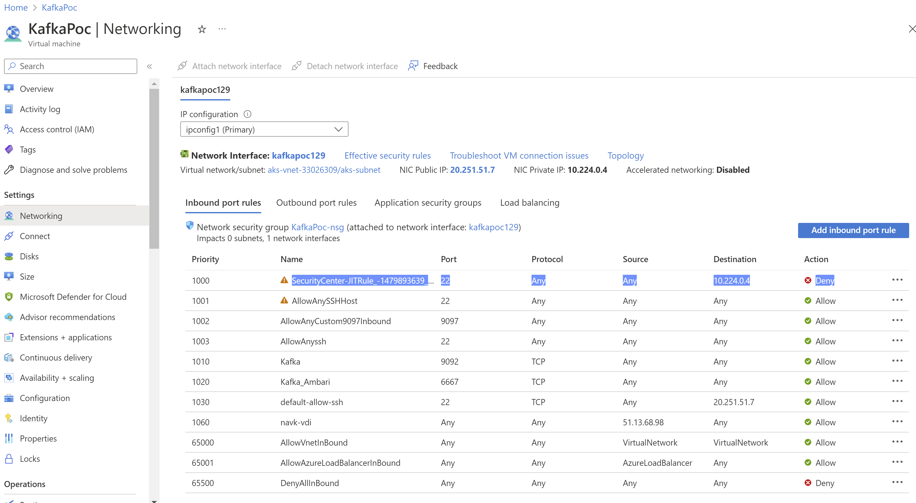
Known Issues
If not able to connect Kafka Server from Putty, then check following rule ‘SecurityCenter-JITRule_-1479893639_0664’ is able to see after login from Azure console and delete this rule to access Kafka VM from outside of Equinor Network

Slide 12
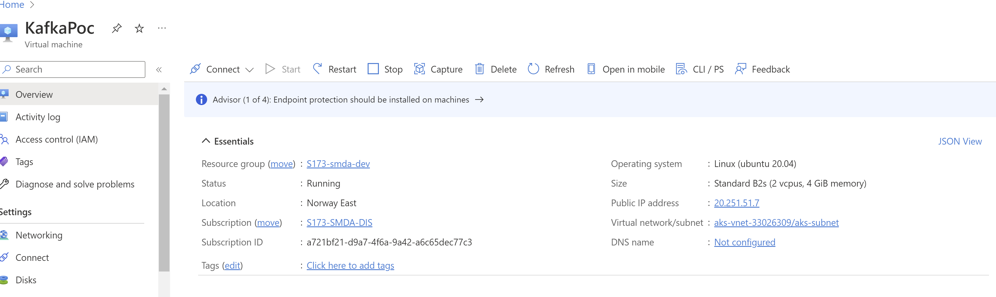
Known Issues
Sometimes even above rule is not configured suddenly Kafka VM stop working so in this case just restart Kafka VM machine from Azure console as below

Slide 13
Known Issues
JDBC connector from connecting database and get the events for insert and update works fine with Tables and Views as well but delete event doesn’t work with JDBC connector
We need to create separate JDBC connector for Insert and Update on same Table
In place of JDBC connector, can use debezium-connector: which will automatically take all events happened on table and place in Kafka Topic with single connector per table, but it doesn’t work on Views
Existing Equinor Elastic data is having more customization and when deleting record in database to delete that same record in elastic search is not possible ,because it is interconnecting with multiple indices .
If it is new workflow from tables and Elasticsearch then Kafka Connector works 100% as expected but can do more redirecting the calls to different topics or rest calls based on input using Kafka Streams

Slide 14
Workflow from Database To Elasticsearch
There are two work flows in Below Diagram
1) One from Database to Elasticsearch (Flow 1)
2) Second one is from Database to Elasticsearch (Flow 2)
Database Table
Kafka Streams
Jdbc/debezium Connector
Kafka Topic
Rest Service or Java or Other Apps
Kafka Topic
Elasticsearch Connector
Elasticsearch Server

